Slide 1
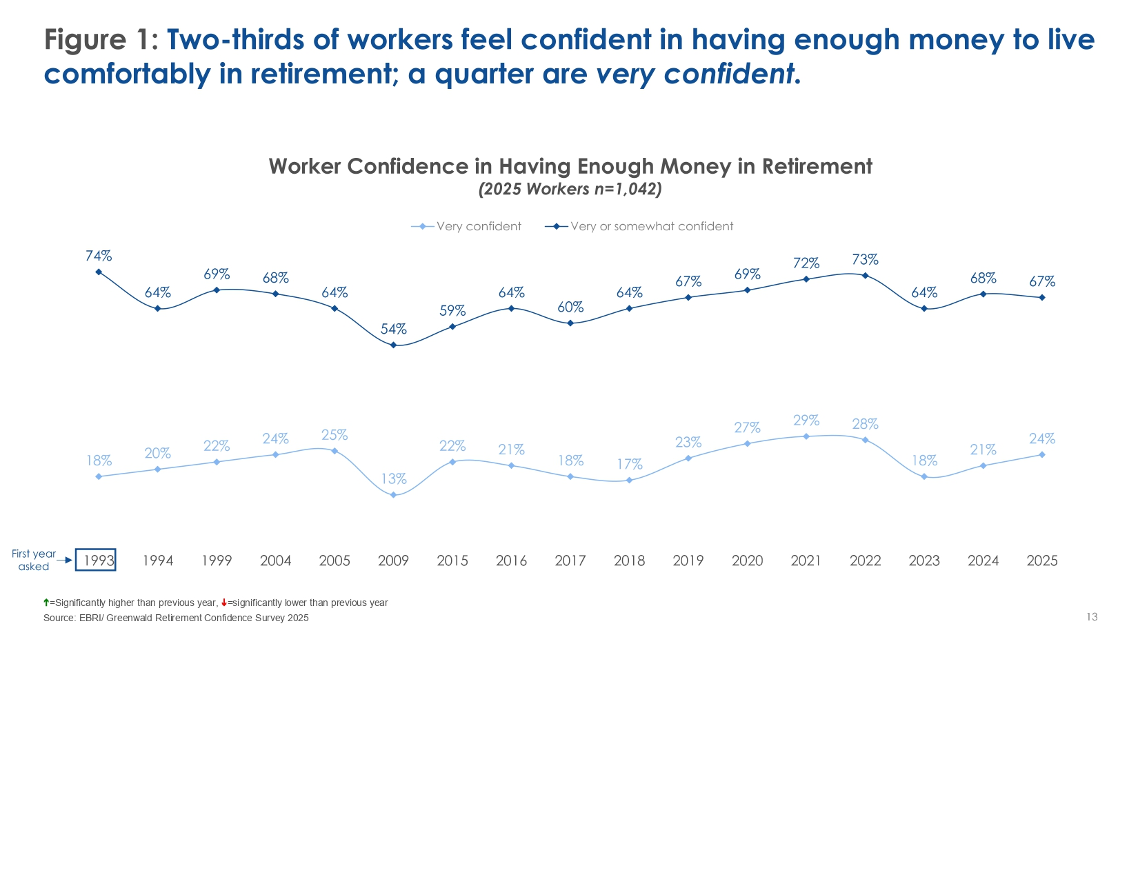

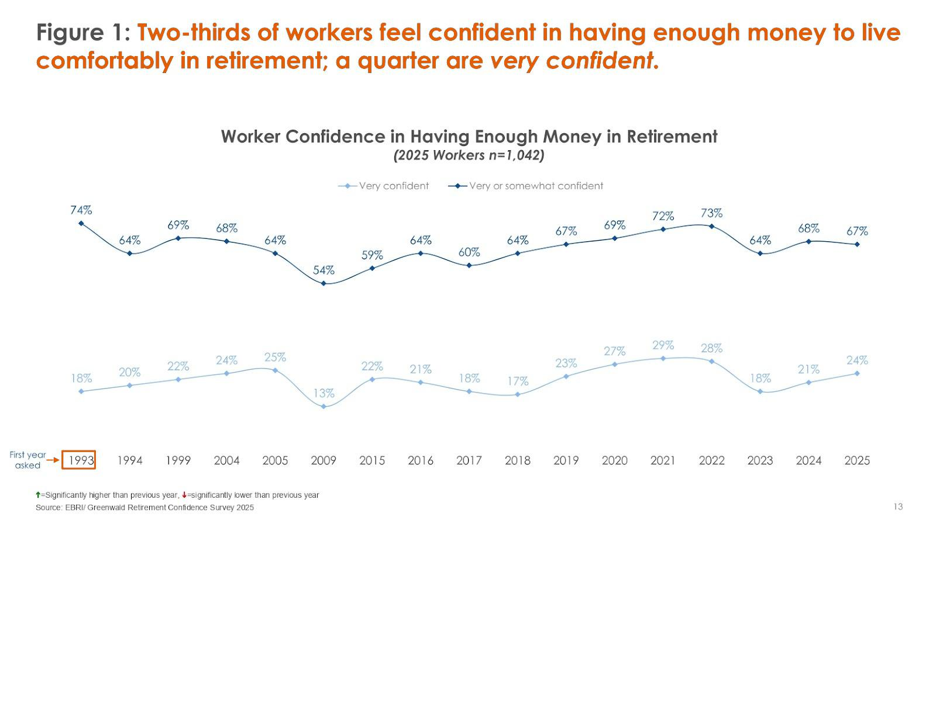

AA
Source: EBRI- Greenwald Retirement Confidence Survey 2025
Notes:
AJINKYA Hello everyone, hope you had a good break between the presentations.
Let me ask one question before we start; Raise your hands Who has planned their retirement.
Many hands: Oh wow, it seems many here have already thought about their retirement. But main question how many of you feel confident about retirement ->explain the stat
Low hands: Based on the avg age present in this room I expected that. But main question how many of you feel confident about retirement ->explain the stat

Slide 2
NestWise
Agentic AI Retirement Guide
Advisor
Dr. Beomjin Kim
Notes:
AJINKYA We are Nestwise: Agenitc AI retirement guide

Slide 3





Team Profile
Ajinkya Abhijit Naik
Anthony Blaze Jackson
OluwaDamilola Williams
Gareth Noble
Gustavo P. C. da Silva
Team Lead
RAG Technician
Agent Orchestrator
AI Pipeline
Backend Engineer
LLM Integration
Frontend Engineer
UI/UX Specialist
Backend Engineer
Prompt Engineering
Notes:
AJINKYA Introduce team

Slide 4
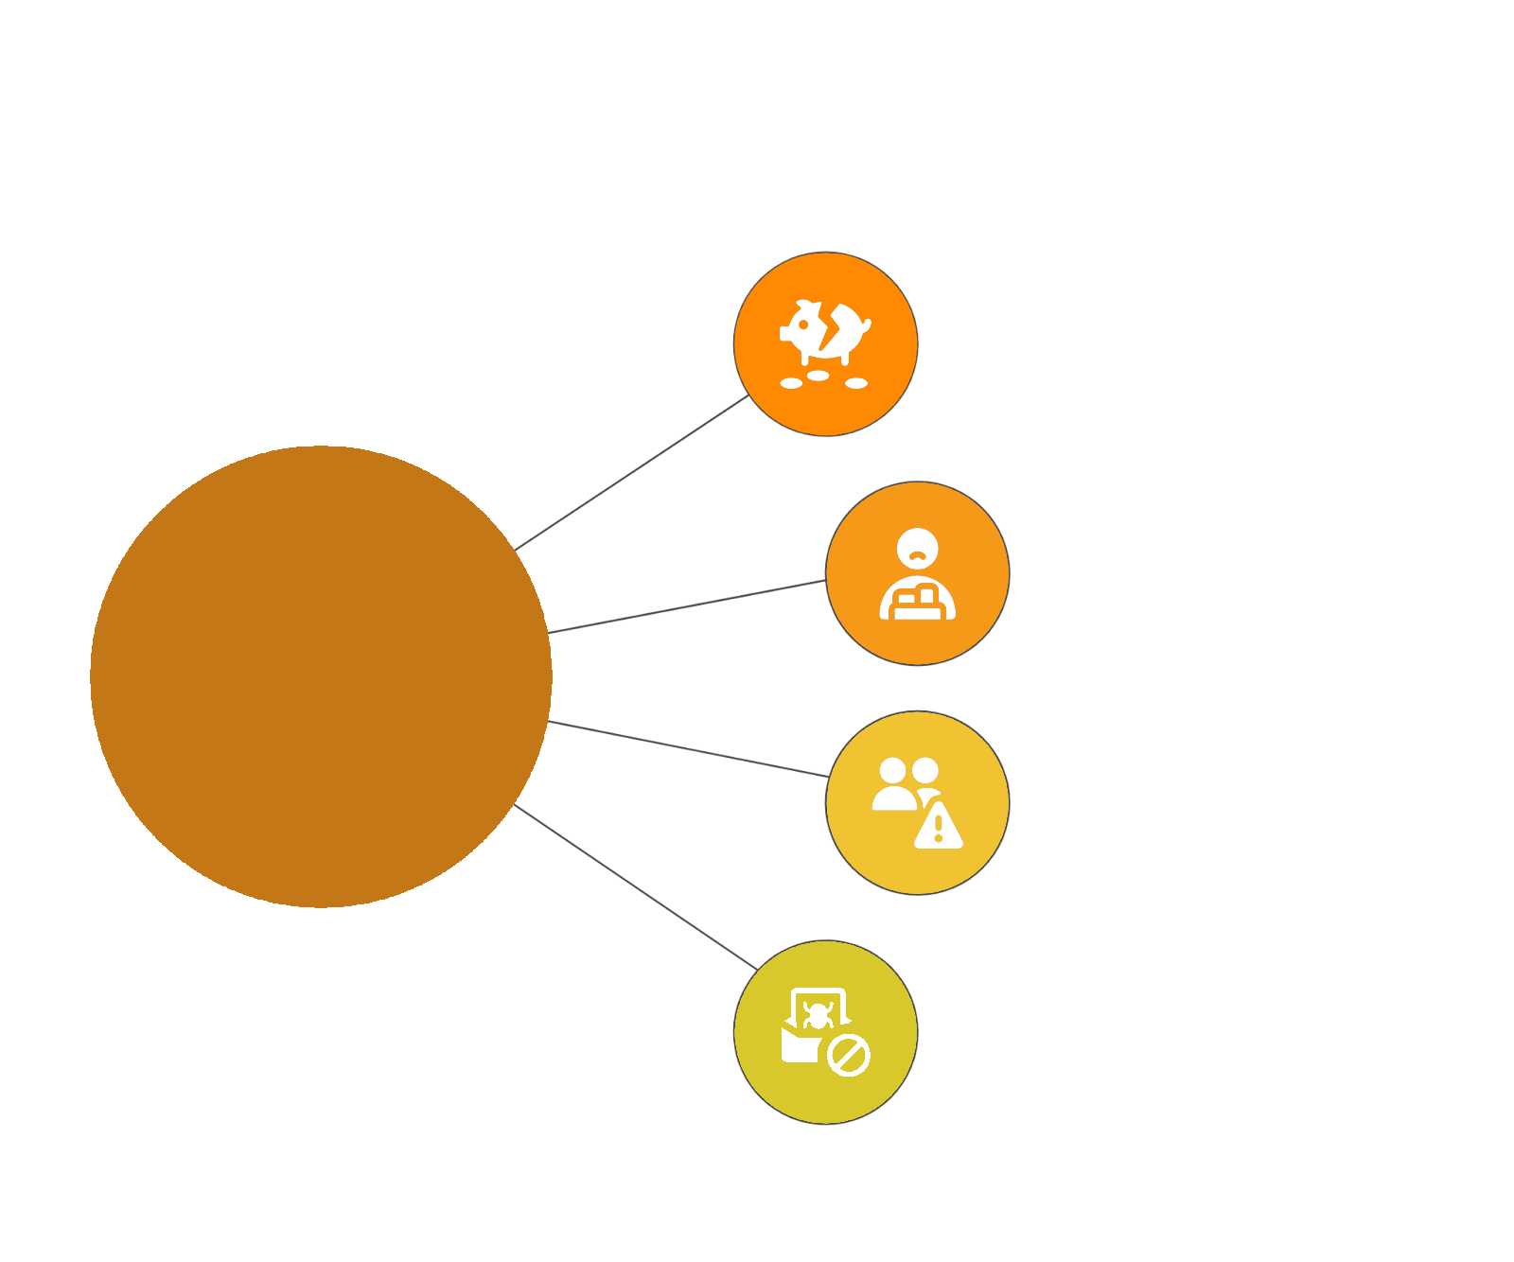

Problem Statement
Fragmented Financial Picture
Low Confidence in Decision Making
Retirement Challenges
Generic & Inconsistent Guidance
Complex Rules & Benefits
Notes:
Most people are unsure whether they’re on track for retirement—and current tools don’t give them the clarity or guidance they need.
Fragmented financial picture — retirement accounts and benefits are spread across platforms with no unified view.
Low confidence in financial decision-making — people struggle to understand what actions will improve retirement readiness.
Generic, inconsistent guidance — most tools provide static advice that doesn’t reflect personal circumstances.
Difficult-to-navigate rules and benefits — complex tax laws and retirement programs make it hard to make optimal choices.

Slide 5
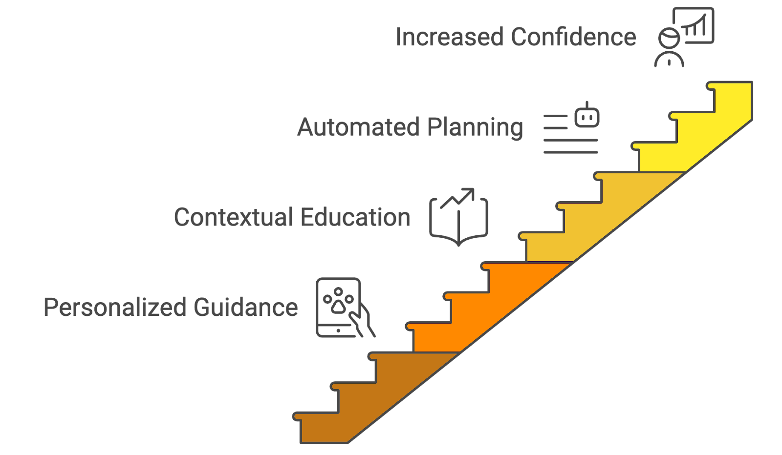
Project Goal
Notes:
We’re building an intelligent, agentic AI system that delivers personalized retirement guidance—simplifying decisions, educating users in context, and helping them build confidence in their long-term financial future.
Provide a unified, accurate snapshot of a user’s retirement readiness.
Deliver personalized, adaptive guidance through an agentic AI, using user-provided information.
Improve users’ understanding of key retirement concepts through contextual education.
Reduce decision-making friction with automated planning, scenario modeling, and actionable next steps.
Increase users’ long-term financial confidence and engagement.

Slide 6




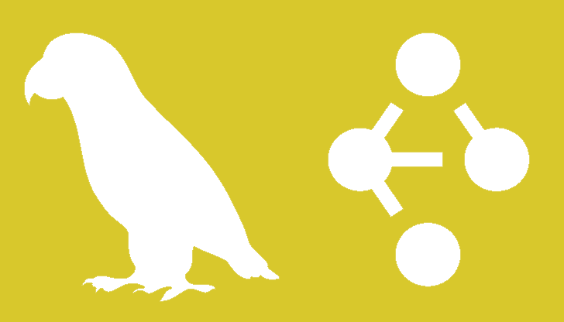
Requirements
Guided User Input
User-centric & intuitive UI for user data collection
Dynamic Prompts
Select prompts based on user interaction, via prompt engineering.
Trusted & Updated Sources
Uses RAG techniques to ensure data accuracy.
LangGraph Framework
Used to orchestrate LLMs and connected tools
Notes:
Relate icons? Too much text, make title bigger
https://registry.npmmirror.com/@lobehub/icons-static-png/latest/files/dark/langgraph-color.png

Slide 7
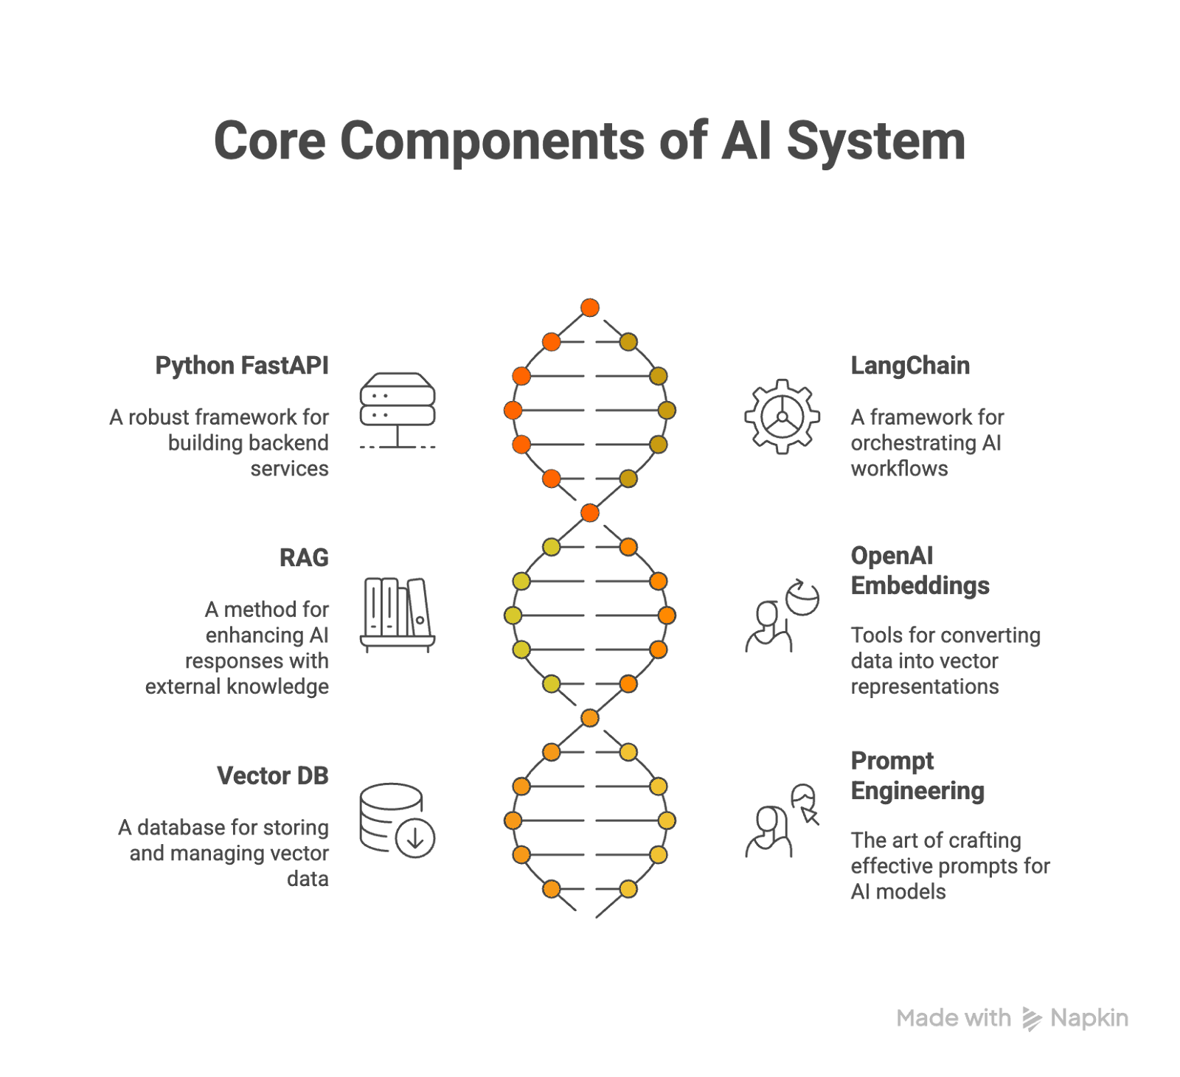
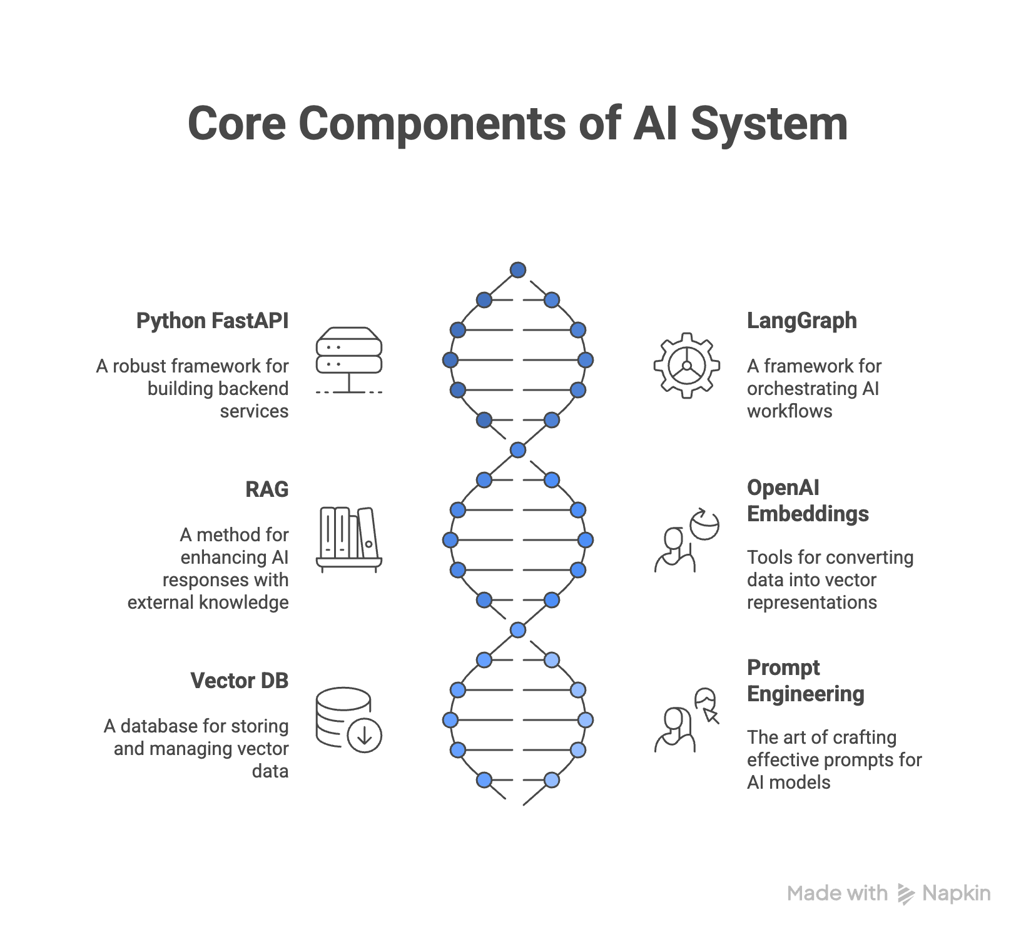

Technology Used
Notes:
DAMI
React.js
Python FastAPI
LangChain
LangGraph
LangSmith
RAG
OpenAI Embeddings
Vector DB
Prompt Engineering

Slide 8
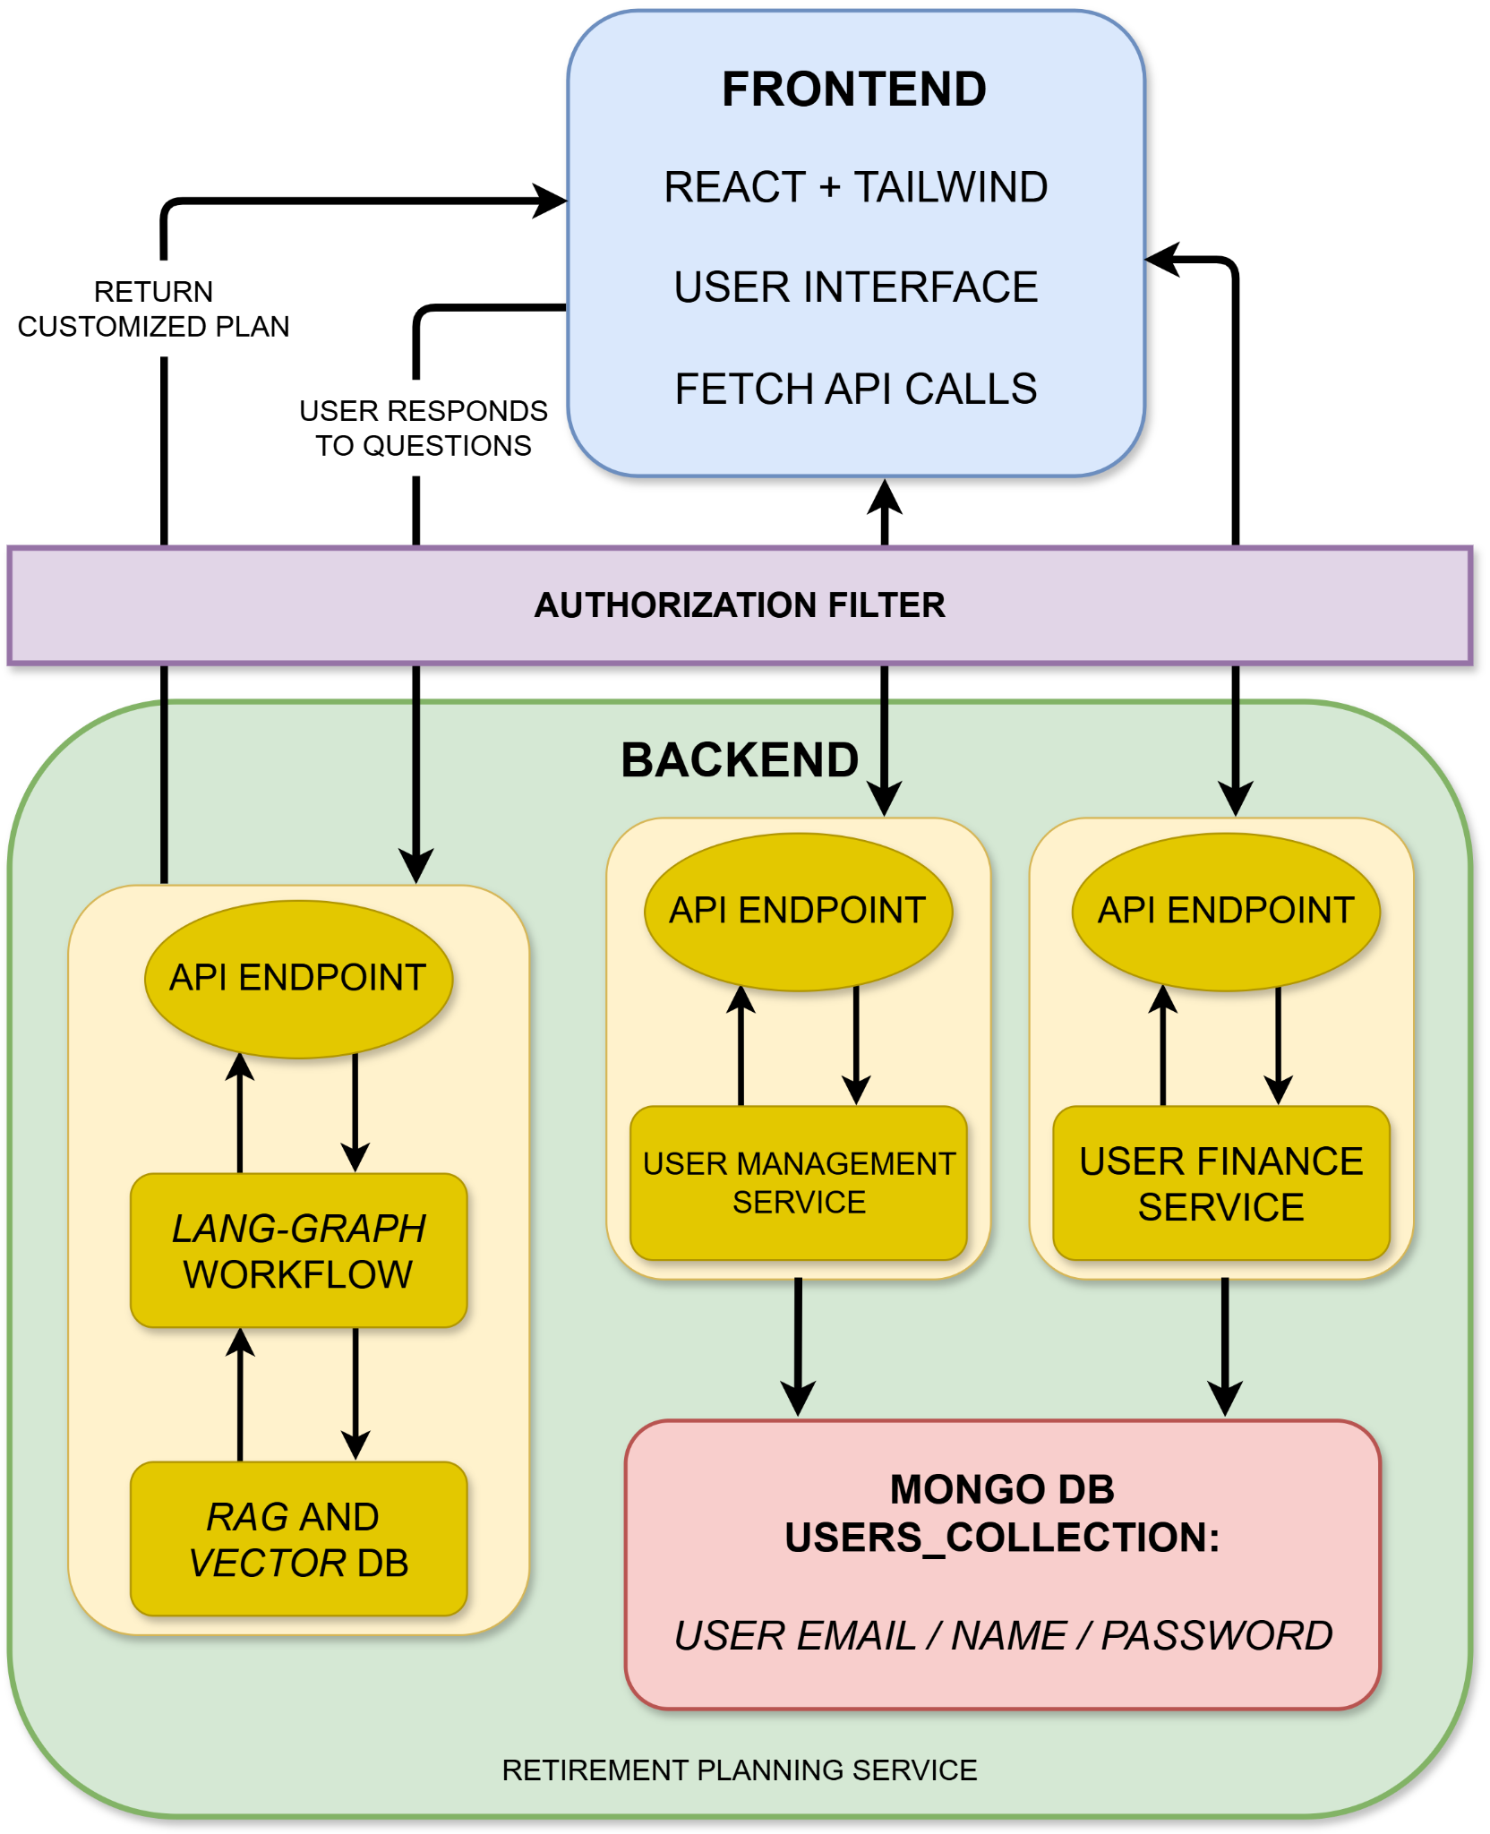
System Architecture
Notes:
Relate icons? Too much text, make title bigger
https://registry.npmmirror.com/@lobehub/icons-static-png/latest/files/dark/langgraph-color.png

Slide 9
Demonstration
Notes:
GARETH, GUSTAVO, BLAZE Planer bot why structured json? LLM Hallucination

Slide 10
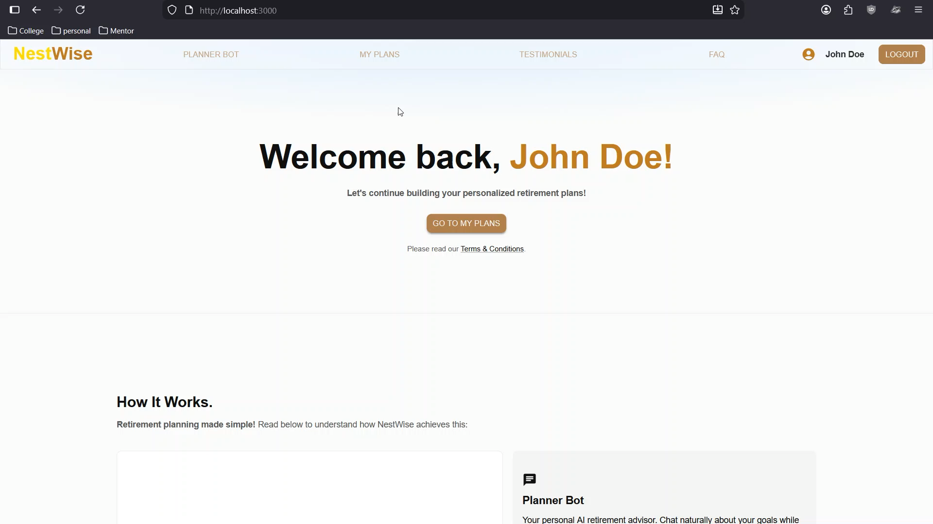
Notes:
GARETH, GUSTAVO, BLAZE Planer bot why structured json? LLM Hallucination

Slide 11
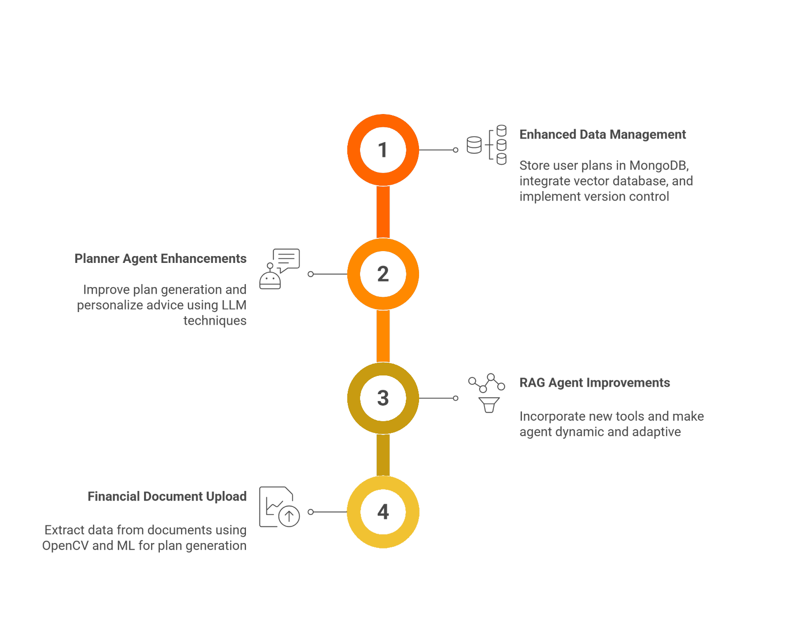
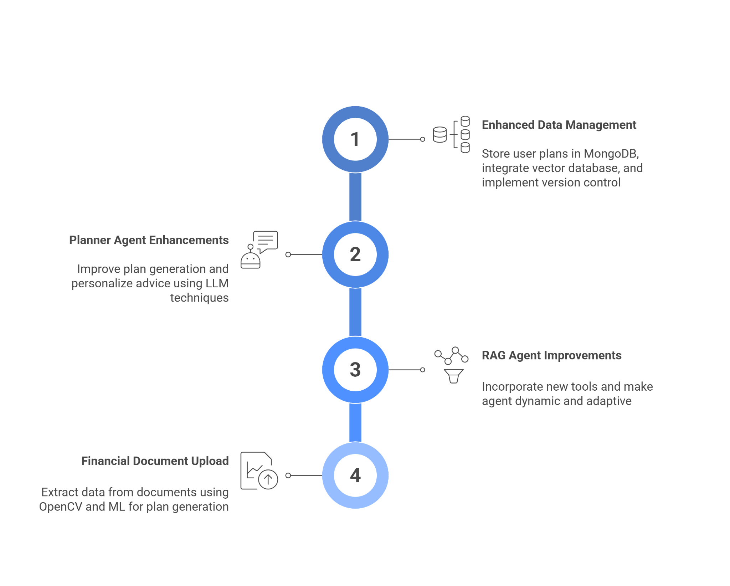
Project Plan for CS46500
Notes:
Gareth Use Vector Embedding for the data storage
Use LLM techniques such as Fine-tuning
Follow rest of the slide

Slide 12
“Retirement confidence should not be a privilege.
Our Mission: Make it accessible to everyone!”
Thank You!
Questions?
Contact us: naika01@purdue.edu
Notes:
Gareth

